Slide 1
Position paper on H2020
SERIT – Security Research in Italy
Cristina Leone and Fabio Martinelli
www.piattaformaserit.it
Feb., 12th 2013 – Rome, CNR

Slide 2
AGENDA and GOAL
Agenda
10.30-10.40 Welcome
10.40-11.00 Presentation of the SERIT Platform
11.00-12.30 Presentation of the SERIT Position Paper for Horizon 2020
12.30-13.15 Discussion
13.15-13.30 Conclusion and wrap-up
Goal
Present the current SERIT position paper for H2020 to institutional stakeholders

Slide 3
SERIT – SEcurity Research in ITaly
SERIT is the Italian Technological Platform, jointly launched by CNR and Finmeccanica, which brings together Italian industries (both large industries and SMEs), academia, research centers and end-users, in order to promote and develop a Research Agenda for future technological developments, answering to the identified National Security needs.

Slide 4
High Level Objectives
Reinforce National and International Cooperation and competitiveness:
SERIT aggregates a number of experts and competencies under different domains, stimulating a fruitful network among stakeholders, users , technologies experts and national institutions.
SERIT promotes a dialogue with end-users and national stakeholders to bridge the industrial and academic research with the real needs and requirements expressed by users.
SERIT acts as a catalyst to access to both national and European funds for research.
Promote the development of Human resources in Security research:
SERIT aims to promote and to develop the human capital in security, by promoting and supporting PhD. in collaboration with industries and academic members of the platform, in order to maintain the national excellences and the know-how in security research.
Contribute to the national technology development and innovation:
SERIT has defined a national technology roadmap.

Slide 5
SERIT is composed by more than 300 members representing more than 250 different organizations

Slide 6
SERIT – a Matrix Organization Technological Areas and Sectors
SERIT had been organized according a Matrix structure composed by 8 Sectors (representing the different area where Security needs to be investigated in Italy) and 7 Technological Areas (identifying the technological priorities).
The structure has been aligned with a wider European strategic vision, always keeping into account the national requirements and priorities identified, by SERIT Members.

Slide 7
Matrix
Situation Awareness
Communications
Detection & Identification
Information Technologies
Technologies for Crisis Management
& People, Assets and
Infrastructures Protection
CBRNE
Transportation Security
Energy Supply System Security
Borders Security
Cybersecurity
Agrifood Security
Health Security
Cultural heritage and Building protection
Smart Cities Security
Legal & Etical Issues

Slide 8
STATUS …
The platform is in continous growth
From 50 to near 300 institutes/departments/organizations since 2011
Main results:
Formal recognition from MIUR as an Italian Technological Platform
Communication strategy based on web site, newsletters and mailing lists (more than 1200 addresses)
Two research roadmaps (2011/2012) published and presented to the Italian community;
Fostering a culture for competitive funding acquisition (several research projects proposals have been created -both at national and international level);
Institution of a SERIT label for PhD fellowships (two awarded from University of Naples);
The Security research day organized at CNR on June 27 with the cooperation of APRE;
The creation of the SERIT Award (won by IREA in Naples for 2012);

Slide 9
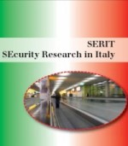
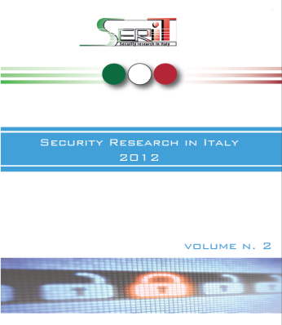
Methodology : how to develop Technologies enabling the needed capabilities for each Domain
In 2011, SERIT was mainly focused on the identification of those required capabilities at National level, through the jointly activities among Sectors (application domains) e Technological Areas representatives (results presented in vol.1);
Domain 1
Domain 2
Domain 8
Technology Area 1
Technology Area 1
Technology Area 2
Research themes
(capabilities)
Technology Area 2
Technology Area 7
Then, a further identification of priorities for research, taking into account European Programs (FP7, H2020, etc) guidelines;
Latest results achieved on 2012,have been published on SERIT vol.2, showing the Research Priorities definition process, gap analysis, costs associated for further developments, evaluation of TRL , and innovation as a result of technological roadmap

Slide 10
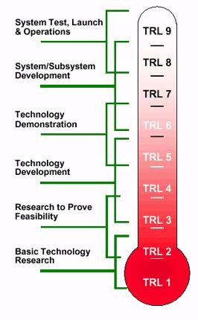
SERIT Roadmap – the concept vs H2020
H2020 Missions
SERIT SG
Techs
TRL/Fundings
Fighting crime and terrorism
Transportation Security
Capabilities
1
Border security
2
Energy Supply Security
3
Cyber security
4
Agrifood Security
Responding to and managing crises and disasters
5
6
Health and Security
Privacy and freedom in the internet and enhancing the societal dimension of security
n
2012
2013
2020

Slide 11
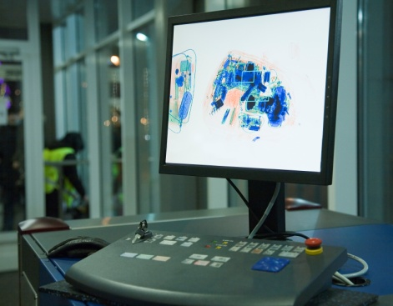
SERIT Roadmap – the concept vs H2020
An example:
Fighting crime and terrorism
Transportation Security
Health and Security
6.9 Strumentazione portatile per il monitoraggio di materiale radioattivo
1.1 Analisi integrate per rilevamento di comportamenti anomali
Energy Supply security
Agrifood Security
1.2 Data Fusion di sensori eterogenei
1.7 Sistemi di sorveglianza perimetrale
6.5 Portali per rivelazione di materiale nucleare o esplosivo dentro i container
1.9 Riconoscimento di scene
6.3 Piattaforme multisensori intelligenti per la riduzione dei falsi allarmi nel monitoraggio di bio-hazard
2.2 Reti wireless ad-hoc e di sensori
2.4 Integrazione del segmento satellitare a supporto di applicazioni evolute
6.2 Stand-off detection di minacce chimiche e biologiche
5.4 Metodologie e sistemi per il monitoraggio di grandi architetture di rete ICT
5.2 Sicurezza del dato
2.6 Network Centric Communication
3.3 Individuazione di eventi anomali
6.1 Rivelazione di composti in tracce (esplosivi, droghe, chimici, biologici, veleni, e loro precursori)
3.1 Sistemi di monitoraggio
3.2 Detection ed imaging di persone e oggetti attraverso gli ostacoli
2.10 Sicurezza di Rete
5.1 Fusione delle informazioni
Sorveglianza & Situation Awareness
TECHNOLOGY AREAS
Comunicazioni
Detection & Identification Systems
Information Processing and Management
CBRNE

Slide 12
Associated Technologies

Slide 13
What is Horizon 2020
Horizon 2020 is the EU Framework Programme for Research and Innovation
It is the financial instrument implementing the Innovation Union concept, the Europe 2020 flagship initiative aimed at securing Europe's global competitiveness
Running from 2014 to 2020 with an €80 billion budget*, the EU’s new programme for research and innovation is part of the drive to create new growth and jobs in Europe.

Slide 14
A time line for Horizon 2020
May 2012: Partial general approach (Council) on H2020
Oct 2012: Partial general approach (Council) on RfP
Nov 2012: ITRE vote (EP) on H2020, spec. Programme, Euratom, RfP
Dec 2012: Partial general approach (Council) on spec. progr H2020
17/01/2013 Rules for Participation –
25/01/2013 Horizon 2020 – Preparation of the Trilogue
31/01/2013 – Trilogue - Preparation of Competitiveness Council Items
18 February 2013 Competitiveness Council
Mar2013: Parliament and Council view on EU (Tri-logues) budget 2014-2020 (including overall budget for Horizon 2020)
2013: Parliament votes on H2020 and RfP
Mid 2013: Adoption of legislative acts by Parliament and Council on Horizon 2020
1/1/2014: Horizon 2020 starts, launch of first calls
Past events
Notes:
Competitiveness Council

Slide 15
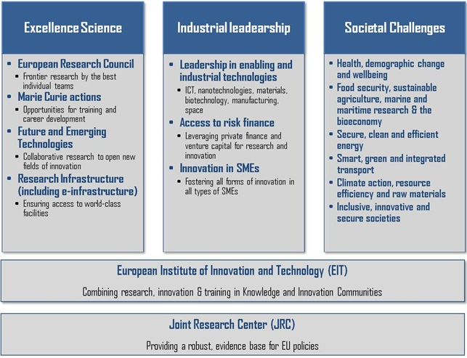
The H2020 New Structure
Horizon 2020 Priorities

Slide 16
Societal challenges
Proposed funding (M€, 2014-2020)
Table 1: EC PROPOSAL |  | Table 2: EP POSITION ITRE 28 NOV 2012 (Text of CA on 26th Nov) |  | DELTA
 |  | -1 (a) new. Science for and with Society | 350,96 | New
1. Health, demographic change and wellbeing; | 9077 of which 292 for EIT | 1. Health and wellbeing | 7896,6 | -13%
2. Food security, sustainable agriculture, marine and maritime research and the bio- economy; | 4694 of which 150 for EIT | 2. Food quality, safety and security, sustainable agriculture and forestry, marine and maritime research and the bio-based industries | 4299,26 | -8,40%
3. Secure, clean and efficient energy | 6537 of which 210 for EIT | 3. Secure, clean and efficient energy | 7370,16 | 12,74%
4. Smart, green and integrated transport | 7690 of which 247 for EIT | 4. Smart, green and integrated transport and mobility | 6054,06 | -21,27%
5. Climate action, resource efficiency and raw materials | 3573 of which 115 for EIT | 5. Climate action, environment, resource efficiency and sustainable use of raw materials; | 3509,6 | -1,77%
6. Inclusive, innovative and secure societies | 4317 of which 138 for EIT | 6. Understanding Europe in a changing world - inclusive, innovative and reflective society | 1491,58 | -22,76%
 |  | 6 (a) new Protecting freedom and security in Europe | 1842,54

Slide 17
Specific thematics addressed by SERIT
In particular we refer to the last available proposals from Commission, Council and Parliament and the specific themes we addressed are:
III Societal challenges, 6a. Secure societies – protecting freedom and security of Europe and its citizens
(a) fight crime and terrorism;
(b) protect and improve resilience of critical infrastructures;
(c) strengthen security through border management and maritime security;
(d) provide cyber security;
(e) increase Europe's resilience to crises and disasters;
(f) enhance the societal dimension of security and ensure privacy and freedom in the Internet;
(g) support the Union's internal and external security policies;
(h) strengthen security and the transformation of conflicts within third countries through conflict prevention, peace-building, dialogue, mediation and reconciliation and civilian security sector reform;
(i) enhance standardization and interoperability;
III Societal challenges, 3. Secure, clean and efficient energy
3.1.3. Foster European Smart cities and Communities
III Societal challenges, 5. Climate Action, Resource Efficiency and Raw Materials
5.6. Cultural heritage

Slide 18
Societal challenges – Protecting freedom and security in Europe
Questi temi sono quelli indicati nella sottotematica prima presente nel 6° pilar
Commissione | Consiglio | Parlamento
6.3.1. Fighting crime and terrorism. | 7.1. Fight crime, illegal trafficking and terrorism, including understanding and tackling terrorist ideas and beliefs | (a) fight crime and terrorism;
 | 7.2. Protect and improve the resilience of critical infrastructures, supply chains and transport modes | (b) protect and improve resilience of critical infrastructures;
6.3.2. Strengthening security through border management | 7.3. Strengthen security through border management | c) strengthen security through border management and maritime security;
6.3.3. Providing cyber security | 7.4. Improve cyber security | (d) provide cyber security;
6.3.4. Increasing Europe's resilience to crises and disasters | 7.5. Increase Europe's resilience to crises and disasters | (e) increase Europe's resilience to crises and disasters;
6.3.5. Ensuring privacy and freedom in the internet and enhancing the societal dimension of security | 7.6. Ensure privacy and freedom, including in the Internet and enhancing the societal legal and ethical understanding of all areas of security, risk and management | (f) enhance the societal dimension of security and ensure privacy and freedom in the Internet;
 |  | (g) support the Union's internal and external security policies;
 |  | (h) strengthen security and the transformation of conflicts within third countries through conflict prevention, peacebuilding, dialogue, mediation and reconciliation and civilian security sector reform;
 | 7.7. Enhance standardisation and interoperability of systems, including for emergency purposes | (i) enhance standatisation and interoperability;

Slide 19
SPEAKERS
Secure societies – protecting freedom and security of Europe and its citizens
(a) fight crime and terrorism → M.Trussardi (Selex-ES)
(b) protect and improve resilience of critical infrastructures →S. Bologna (AIIC)
(c) strengthen security through border management and maritime security → S.Pasquariello (Selex ES)
(d) provide cyber security → L.Romano (CINI)
(e) increase Europe's resilience to crises and disasters → P.Fichera (ENEA)
(f) enhance the societal dimension of security and ensure privacy and freedom in the Internet → M.Savastano (CNR)
(g) support the Union's internal and external security policies; → M.A.Corbucci (Finmeccanica) per F.Di Camillo (IAI)
enhance standardization and interoperability → M.Luglio (Univrsità Tor Vergata)
Secure, clean and efficient energy
3.1.3. Foster European Smart cities and Communities → V.Cuomo (CNR)
Climate Action, Resource Efficiency and Raw Materials
5.6. Cultural heritage → L. Moltedo (CNR)

